Slide 1


Health Care Management System
This presentation outlines the design and implementation of a Health Care Management System database, encompassing patient records, appointments, billing, and lab test management.
Notes:
1

Slide 2
Project Overview
Course
Group Members
BUAN 6320 – Database Foundations for Business Analytics
Don Thoppil Jain,
Sushma Bukkapuram,
Tara Canugovi,
Mounika Kolle,
Venkata Lakshmi Ishwarya Tatavarthi
Notes:
2

Slide 3


Introduction
This database design document outlines the requirements and defines the Entity Relationship Diagram (ERD) for a Health Care Management System. The system enables patients to book appointments, manage medical records, and track lab test results.
Notes:
3

Slide 4
Entities and Attributes
Patients
Doctor
PatientID, Name, DateOfBirth, Gender, ContactInfo, Address, MedicalHistory
DoctorID, Name, Department, Specialty, Experience, ContactInfo
Appointment
Billing
AppointmentID, PatientID, DoctorID, Date, AppointmentReason, Status
BillID, PatientID, AppointmentID, TotalAmount, Date, PaymentStatus, InsuranceDetails
MedicalRecord
Lab_Tests
RecordID, PatientID, AppointmentID, DoctorID, Notes, Treatment
TestID, RecordID, TestName, TestDate, Result, DoctorNotes
Notes:
4

Slide 5
Relationship and Cardinality
Patients - Appointments: 1:M
Doctors - Appointments: 1:M
Patients - MedicalRecords: 1:M
Appointments - MedicalRecords: 1:1
Doctors - MedicalRecords: 1:M
MedicalRecords - LabTests: 1:M
Patients - Billing: 1:M
Appointments - Billing: 1:1
Notes:
5

Slide 6
Assumptions and Special Considerations
1
Patient Registration
2
Unique Identifiers
3
Standardized Contact Information
Patients must be registered before scheduling appointments.
Each entity has a unique identifier for accurate data tracking.
Contact information is stored in a consistent format.
4
Insurance Information
5
Role-Based Access Control
Billing records include insurance details and payment status.
Access to sensitive patient data is limited by user roles.
Notes:
6

Slide 7
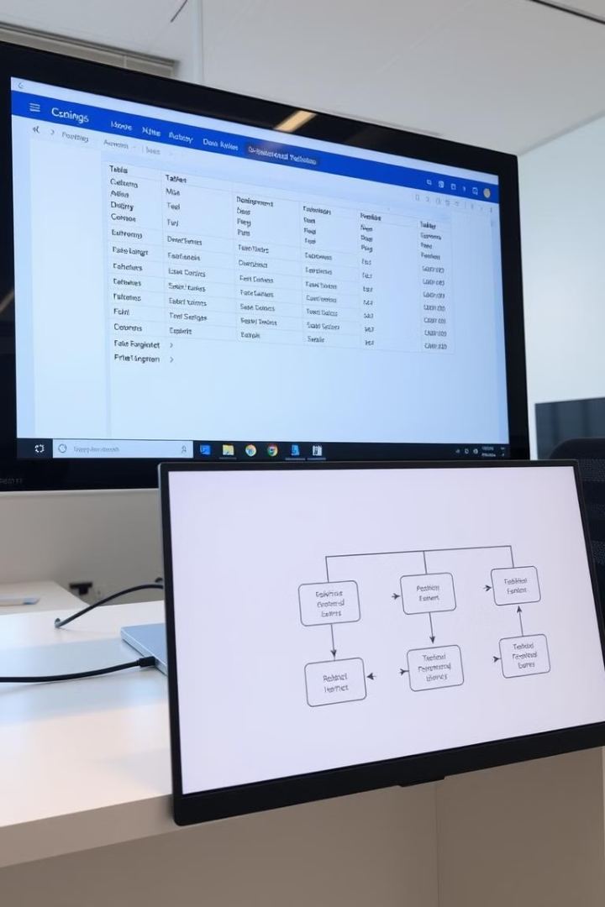
Normalization Process
1NF : Ensured atomicity, removed repeating groups.
2NF : Moved Performance metrics from content to a separate table.
3NF : Removed transitive dependencies like in the Billing table.
Notes:
7

Slide 8
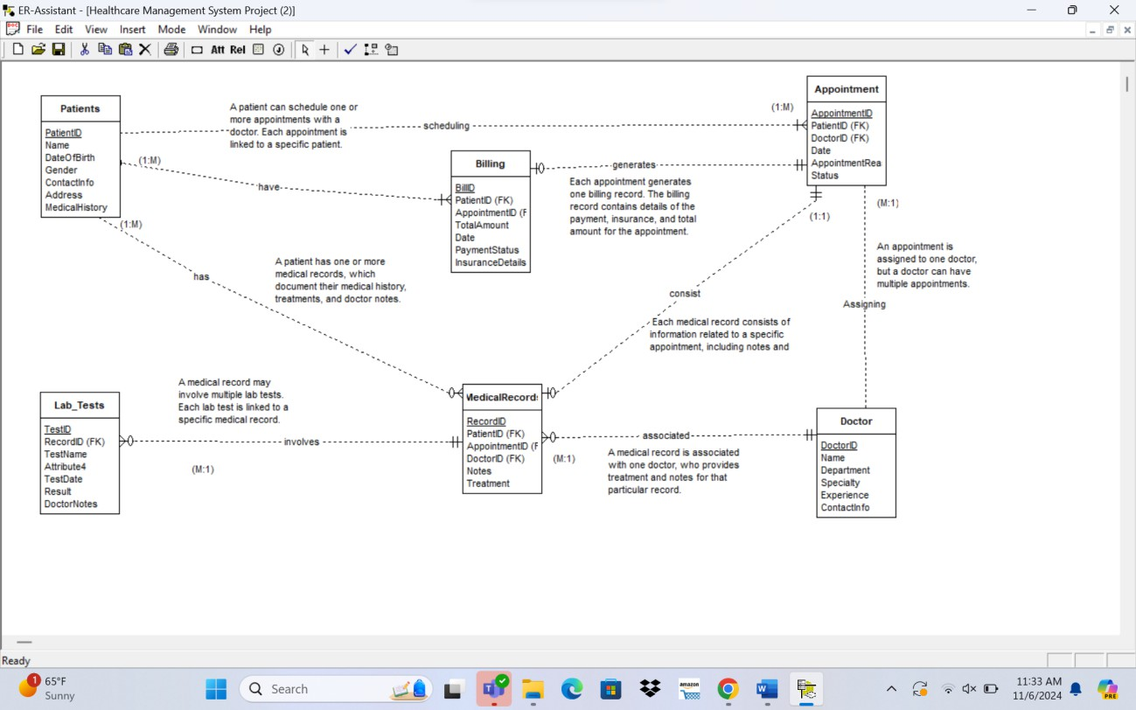
Entity Relationship Diagram (ERD)
The ERD visually represents the entities, attributes, relationships, and cardinality of the Health Care Management System database.
Notes:
8

Slide 9

Data Definition Language (DDL)
The DDL script defines the tables, their attributes, data types, and relationships. It includes sequences, triggers, and views for managing data integrity and providing efficient data access.
SEQUENCES:
CREATE SEQUENCE patient_id_seq
START WITH 1
INCREMENT BY 1
NO MINVALUE
NO MAXVALUE
CACHE 1;
CREATE SEQUENCE doctor_id_seq
START WITH 100
INCREMENT BY 1
NO MINVALUE
NO MAXVALUE
CACHE 1;
CREATE SEQUENCE appointment_id_seq
START WITH 1000
INCREMENT BY 1;
CREATE SEQUENCE record_id_seq
START WITH 3000
INCREMENT BY 1
NO MINVALUE
NO MAXVALUE
CACHE 1;
CREATE SEQUENCE test_id_seq
START WITH 7000
INCREMENT BY 1
NO MINVALUE
NO MAXVALUE
CACHE 1;
CREATE SEQUENCE bill_id_sequen
START WITH 5000
INCREMENT BY 1
NO MINVALUE
NO MAXVALUE
CACHE 1;
Notes:
9

Slide 10
Data Definition Language (DDL)
TRIGGERS AND FUNCTIONS:
CREATE OR REPLACE FUNCTION assign_record_id()
RETURNS TRIGGER AS $$
BEGIN
NEW.RecordID := nextval('record_id_seq');
RETURN NEW;
END;
$$ LANGUAGE plpgsql;
CREATE OR REPLACE FUNCTION assign_test_id()
RETURNS TRIGGER AS $$
BEGIN
NEW.TestID := nextval('test_id_seq');
RETURN NEW;
END;
$$ LANGUAGE plpgsql;
CREATE OR REPLACE FUNCTION assign_bill_id()
RETURNS TRIGGER AS $$
BEGIN
NEW.BillID := nextval('bill_id_sequen');
RETURN NEW;
END;
$$ LANGUAGE plpgsql;
CREATE OR REPLACE FUNCTION assign_patient_id()
RETURNS TRIGGER AS $$
BEGIN
NEW.PatientID := nextval('patient_id_seq');
RETURN NEW;
END;
$$ LANGUAGE plpgsql;
CREATE OR REPLACE FUNCTION assign_doctor_id()
RETURNS TRIGGER AS $$
BEGIN
NEW.DoctorID := nextval('doctor_id_seq');
RETURN NEW;
END;
$$ LANGUAGE plpgsql;
CREATE OR REPLACE FUNCTION assign_appointment_id()
RETURNS TRIGGER AS $$
BEGIN
NEW.AppointmentID := nextval('appointment_id_seq');
RETURN NEW;
END;
$$ LANGUAGE plpgsql;

Slide 11
Data Manipulation Language - DML: DML consists of SQL commands used to retrieve, insert, update, and delete data in a database. It allows users to manipulate data stored in tables without affecting the database structure.
Examples of DML Commands:
SELECT: Retrieves data from one or more tables.
INSERT: Adds new rows to a table.
UPDATE: Modifies existing data in a table.
DELETE: Removes rows from a table.

Slide 12
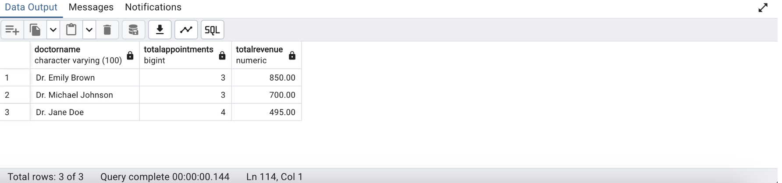
Advanced Queries with Outputs
Show the total number of appointments and total revenue generated by each doctor order by revenue
SELECT d.Name AS DoctorName,
subquery.TotalAppointments,
subquery.TotalRevenue
FROM Doctor d
JOIN (
-- Subquery to calculate total appointments and revenue for each doctor
SELECT a.DoctorID,
COUNT(a.AppointmentID) AS TotalAppointments,
SUM(b.TotalAmount) AS TotalRevenue
FROM Appointment a
JOIN Billing b ON a.AppointmentID = b.AppointmentID
GROUP BY a.DoctorID
) subquery ON d.DoctorID = subquery.DoctorID
ORDER BY subquery.TotalRevenue DESC;

Slide 13
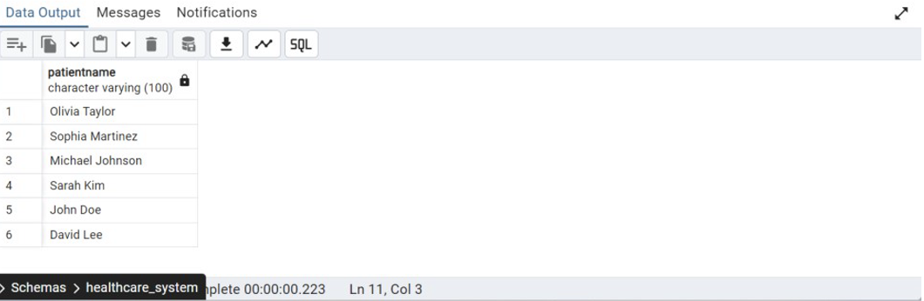
Identify the patients who have completed all their payments and are not associated with any pending payment status in the billing system
SELECT DISTINCT p.Name AS PatientName
FROM Patients p
JOIN MedicalRecord m ON p.PatientID = m.PatientID
JOIN Lab_Tests l ON m.RecordID = l.RecordID
WHERE p.PatientID NOT IN (
SELECT b.PatientID
FROM Billing b
WHERE b.PaymentStatus = 'Pending'
);
Advanced Queries with Outputs

Slide 14

Challenges
Handling intricate relationships among patients, doctors, appointments, medical records, and billing systems while ensuring data consistency and integrity.
Ensuring efficient database queries and real-time data retrieval for vast amounts of patient records, diagnostic reports, and treatment histories
Implementing robust triggers and functions to automate essential processes, such as auto-assigning and incrementing unique IDs for patients, doctors, appointments, medical records, tests, and billing entries.

Slide 15

Conclusion
The well-designed Health Care Management System database enhances operational efficiency and improves data security. It supports effective patient care and provides a robust foundation for future advancements.
Notes:
10

